Slide 1
SuperKart Project
Post Graduate Program in Artifical Intelligence and Machine Learning
Prepared by Christian Caceres
June 6, 2026

Slide 2
Contents / Agenda
Executive Summary
Business Problem Overview and Solution Approach
Data Overview
EDA Results
Data Preprocessing
Model Building
Model Performance Summary
Deployment
Conclusions and Recommendations

Slide 3
Executive Summary
An exploratory data analysis (EDA) was conducted to identify the key factors influencing SuperKart's sales performance across products, stores, and regions. The analysis revealed that product attributes, store characteristics, and location-based factors significantly impact sales outcomes. Variables such as product visibility, weight, MRP, outlet type, outlet size, and outlet location tier emerged as important drivers of revenue, while notable sales variations across store formats highlighted opportunities for more targeted inventory and merchandising strategies.
To address these business challenges, multiple machine learning regression models were developed and evaluated to forecast product-store sales revenue. Model performance was assessed using industry-standard metrics, including RMSE, MAE, and R², to ensure both predictive accuracy and generalization on unseen data. Among the models tested, the Tuned XGBoost Regressor delivered the strongest overall performance, achieving the lowest prediction error and highest predictive accuracy. Based on its superior results, the Tuned XGBoost Regressor was selected as the final model for deployment. The deployed solution provides SuperKart with a scalable, data-driven forecasting capability that supports inventory optimization, demand planning, and more informed business decision-making across its retail network.

Slide 4
Business Problem Overview and Solution Approach
Problem Overview:
SuperKart operates across multiple stores, regions, and product categories, making accurate sales forecasting critical for inventory management and business planning. Variations in demand, products, pricing, and store characteristics make manual forecasting unreliable and difficult to scale:
Key Challenges:
Demand variability across stores and products.
Inventory inefficiencies, including stockouts and overstocking.
Forecasting methods that do not scale across regions.
Solution Approach:
A machine learning–based sales forecasting solution was developed to predict product-store sales revenue using historical data, product attributes, and store characteristics. The project included data preparation, feature engineering, and Exploratory Data Analysis (EDA) to identify key sales drivers and patterns.
Multiple regression models were built, evaluated, and optimized to determine the best-performing forecasting model. The selected model was then deployed through a backend API and user-friendly frontend application, enabling business users to generate accurate sales forecasts and support inventory, supply chain, and operational planning across SuperKart stores.

Slide 5
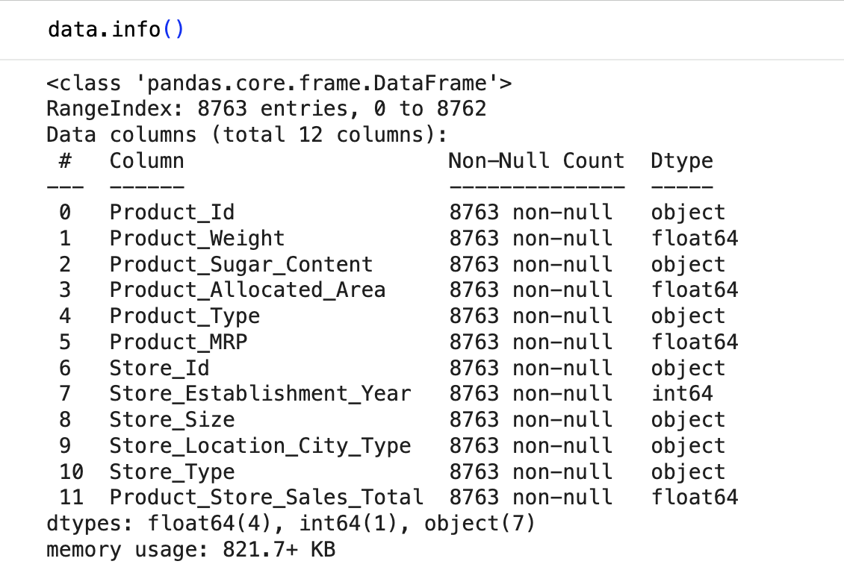
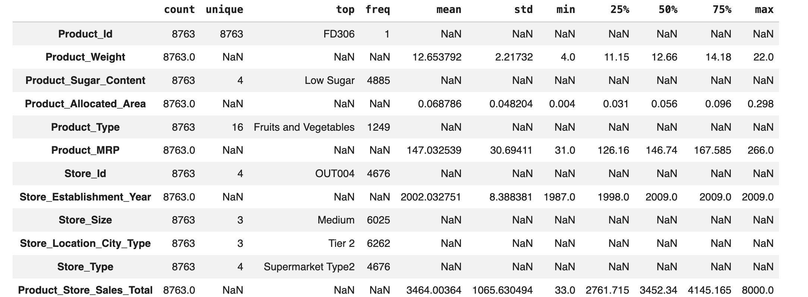
Data Overview
The dataset contains 8,763 rows and 12 columns
Target Variable: Product_Store_Sales_Total
Missing Values: None
Duplicated Values: None
Categorical variables require encoding before modeling
Product Insights: Low Sugar products dominate the inventory, Fruits and Vegetables are the largest product category, and Product_MRP shows a wide price range, making it a likely key driver of sales.
Store Insights: The data is concentrated in Medium-sized stores, Tier 2 cities, and Supermarket Type2 locations, indicating potential imbalances that may influence sales patterns and model performance.
Sales Performance: Product_Store_Sales_Total exhibits substantial variability (33–8,000 units sold), suggesting strong opportunities for machine learning models to identify the factors that drive high and low sales performance.

Slide 6
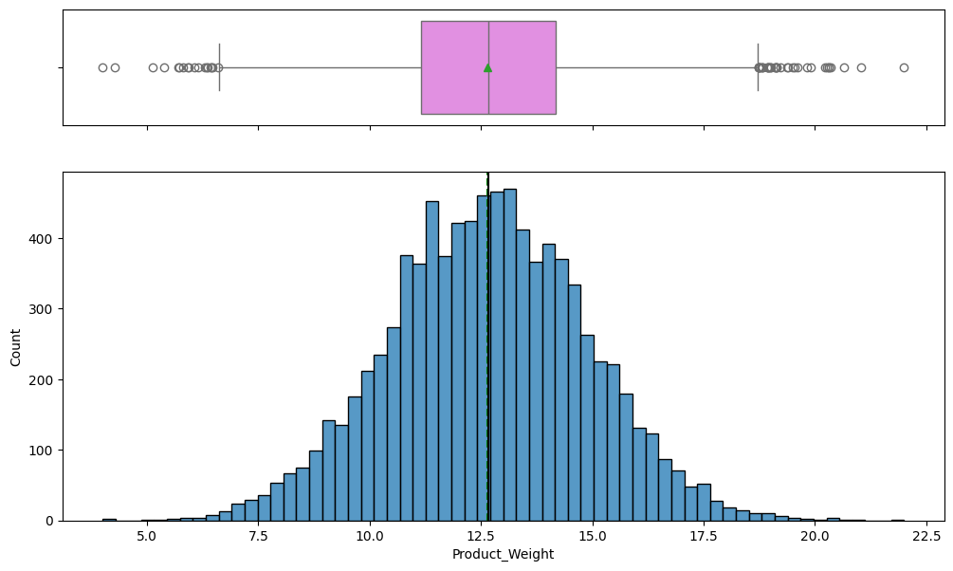
EDA Results Univariate Analysis: Product Weight
Product weight is approximately normally distributed, centered around 12.5–13.
Mean and median are very close, indicating minimal skewness in the main distribution.
Several outliers exist on both the lower and higher ends of the weight range.
Most products fall within a relatively narrow weight range, suggesting standardized packaging sizes

Slide 7
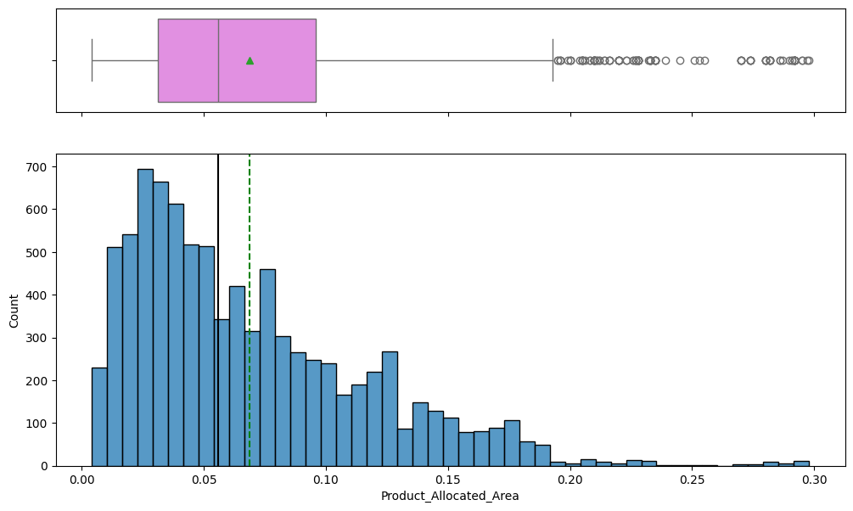
EDA Results Univariate Analysis: Product Allocated Area
Product allocated area is positively skewed, with most products receiving smaller shelf space allocations.
Mean is higher than the median, indicating the presence of high-value outliers with significantly larger allocated areas.
Several extreme outliers exist above 0.20, suggesting a small number of products dominate shelf space.
Majority of products are concentrated below 0.10 allocated area, indicating limited shelf distribution for most items.

Slide 8
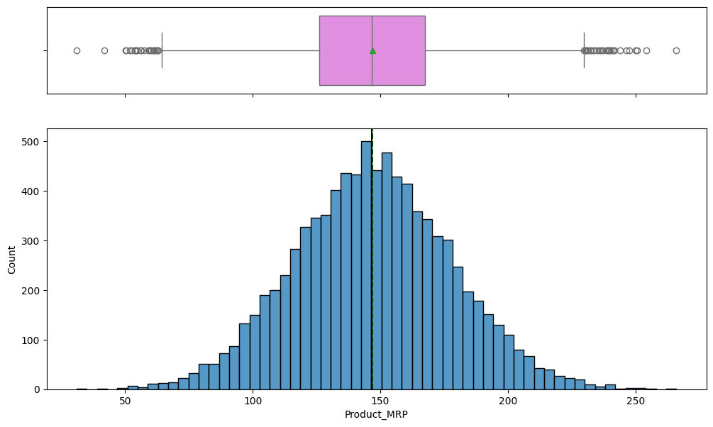
EDA Results Univariate Analysis: Product MRP
Product MRP is approximately normally distributed, centered around 145–150. Mean and median are closely aligned, indicating a fairly symmetric distribution.
Most products fall within the mid-price range, suggesting balanced pricing across the catalog.
A few low and high price outliers exist, indicating the presence of budget and premium product segments.

Slide 9
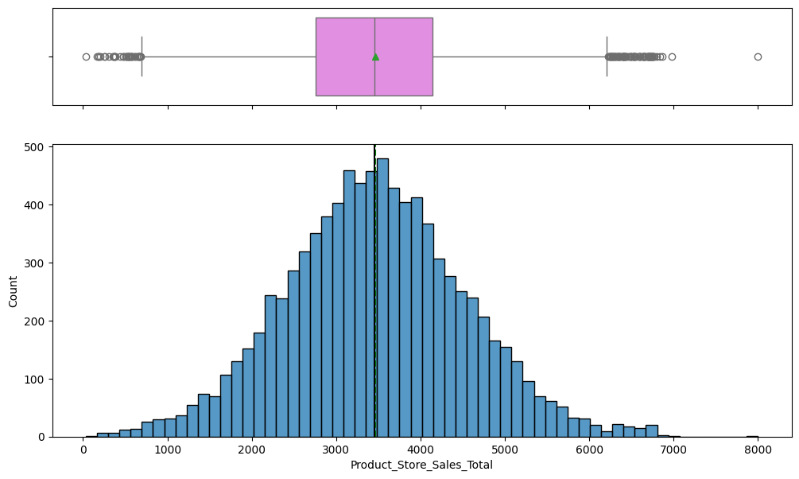
EDA Results Univariate Analysis: Product Sales Total
Product store sales are approximately normally distributed, centered around 3,400–3,600.
Mean and median are closely aligned, indicating a relatively symmetric distribution.
Most products generate sales within a moderate range, with fewer extremely low or high sales values.
Several outliers exist on both ends, indicating a small number of products significantly underperform or outperform the average.

Slide 10
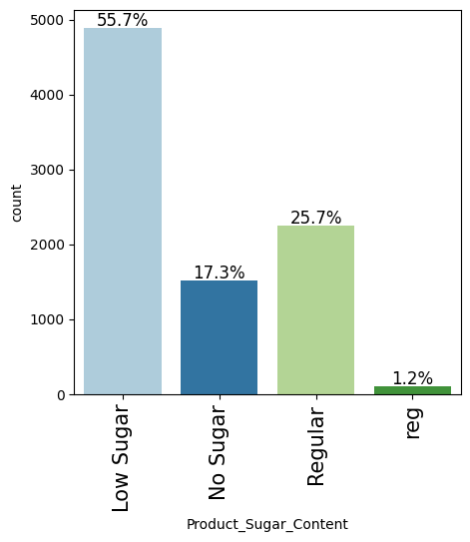
EDA Results Univariate Analysis: Product Sugar Content
Low Sugar products dominate the dataset, accounting for 55.7% of all products.
Regular sugar products represent 25.7% of the product mix, indicating strong presence of traditional offerings.
No Sugar products account for 17.3%, reflecting moderate demand for sugar-free alternatives.
The “reg” category represents only 1.2%, suggesting either a very limited segment or possible data inconsistency/category duplication.

Slide 11
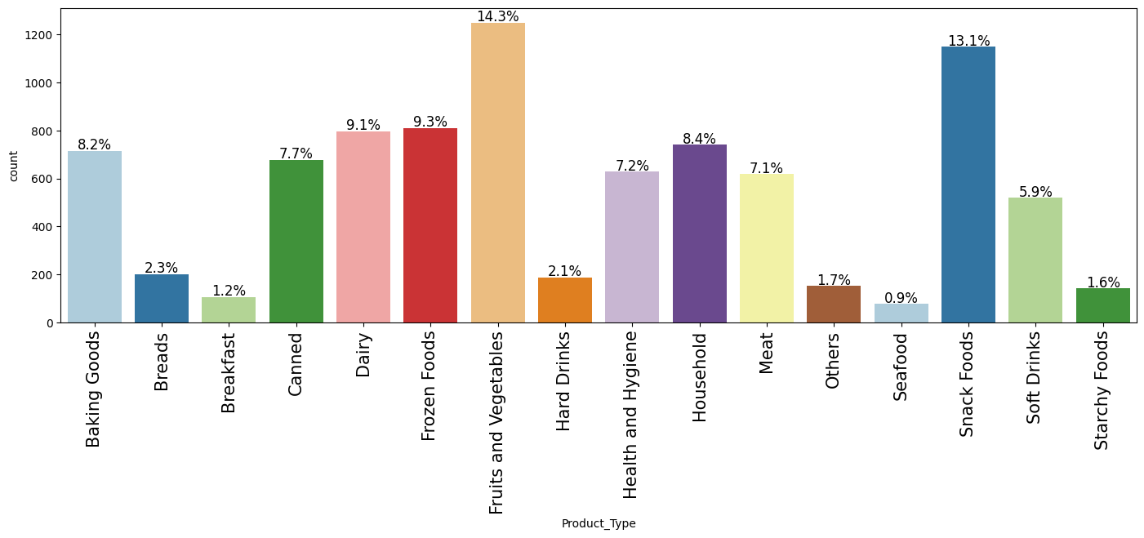
EDA Results Univariate Analysis: Product Type
Fruits and Vegetables is the largest product category, representing 14.3% of all products.
Snack Foods account for 13.1%, making it another major category in the product portfolio.
Frozen Foods (9.3%) and Dairy (9.1%) also contribute significantly to the assortment mix.
Seafood (0.9%) and Breakfast items (1.2%) represent the smallest product categories.
Product distribution is uneven across categories, indicating stronger focus on high-demand food segments.

Slide 12
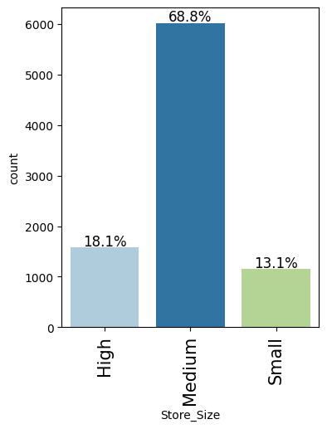
EDA Results Univariate Analysis: Store Size
Medium-sized stores dominate the dataset, representing 68.8% of all stores.
High-sized stores account for 18.1%, while small stores represent only 13.1%.
The store distribution is heavily concentrated toward medium-sized formats.
The company appears to prioritize medium-sized stores as its primary retail strategy.

Slide 13
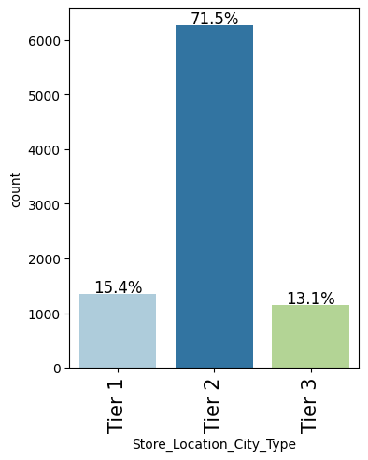
EDA Results Univariate Analysis: Store Location City Type
Tier 2 cities dominate the dataset, accounting for 71.5% of all store locations.
Tier 1 stores represent 15.4%, while Tier 3 stores account for 13.1%.
The company’s retail presence is heavily concentrated in Tier 2 cities.
This distribution suggests a strategic focus on mid-sized urban markets with strong consumer demand potential.

Slide 14
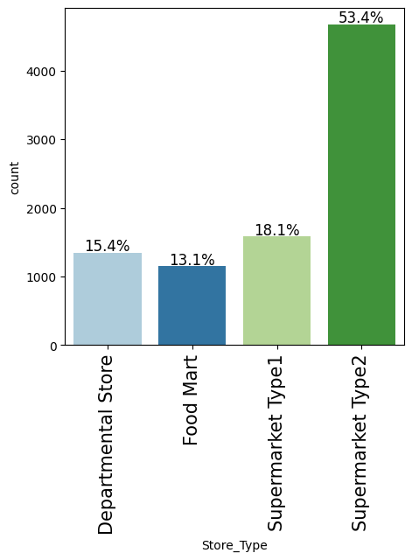
EDA Results Univariate Analysis: Store Type
Supermarket Type2 dominates the dataset, representing 53.4% of all stores.
Supermarket Type1 accounts for 18.1%, while Department Stores represent 15.4%.
Food Mart has the smallest share at 13.1% of total stores.
The company’s retail network is primarily concentrated in the Supermarket Type2 format, indicating it is the core operating model.

Slide 15
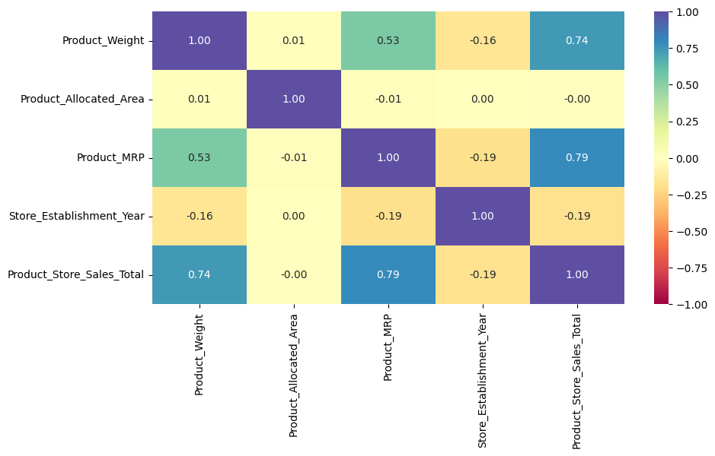
EDA Results Bivariate Analysis: Correlation Matrix
Product MRP has the strongest positive correlation with Product Store Sales Total (0.79), indicating higher-priced products tend to generate higher sales.
Product Weight also shows a strong positive correlation with Product Store Sales Total (0.74).
Product Weight and Product MRP are moderately positively correlated (0.53), suggesting heavier products are often priced higher.

Slide 16
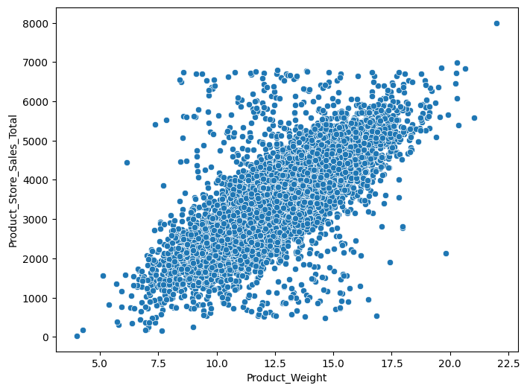
EDA Results Bivariate Analysis: Product Weight vs Product Store Sales
Product Weight shows a strong positive relationship with Product Store Sales Total.
Higher product weights are generally associated with higher sales values.
Most observations are concentrated between product weights of 8–18 and sales totals of 1,500–5,500.
The scatterplot indicates Product Weight may be an important predictor of sales performance.

Slide 17
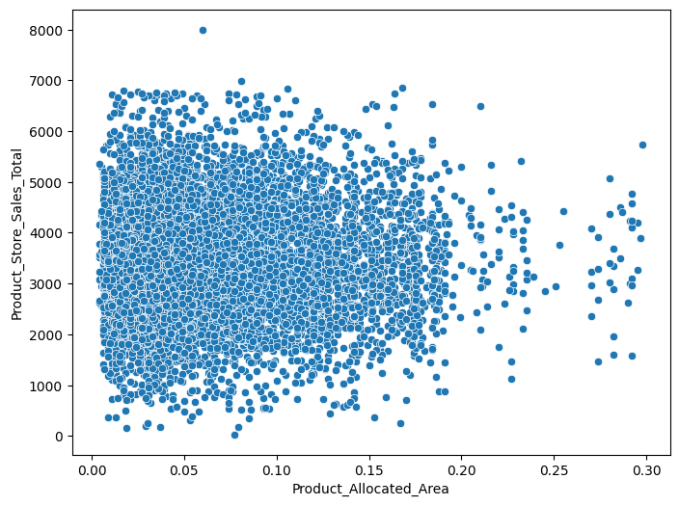
EDA Results Bivariate Analysis: Product Allocated Areas vs Total Sales
Product Allocated Area shows little to no strong linear relationship with Product Store Sales Total.
Sales values are widely dispersed across all allocation levels, indicating weak correlation.
Most products are concentrated within lower allocated area values below 0.15.
A few products with large allocated areas achieve high sales, but similar sales levels are also observed at smaller allocation sizes.

Slide 18
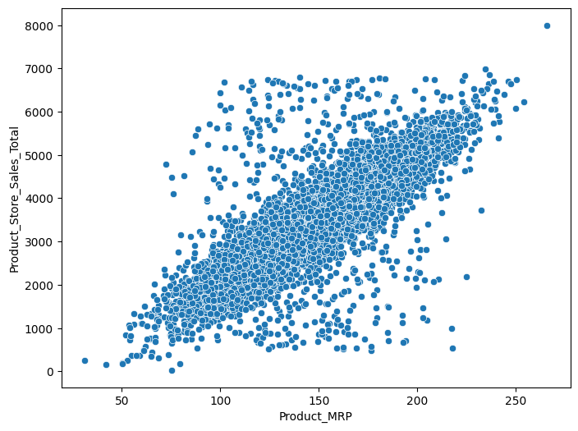
EDA Results Bivariate Analysis: Product MRP Area vs Total Sales
Product MRP shows a strong positive relationship with Product Store Sales Total.
Higher-priced products generally generate higher sales values.
Most observations are concentrated between MRP values of 100–220 and sales totals of 1,500–6,000.
The scatterplot displays a clear upward trend, indicating Product MRP is a strong predictor of sales performance.

Slide 19
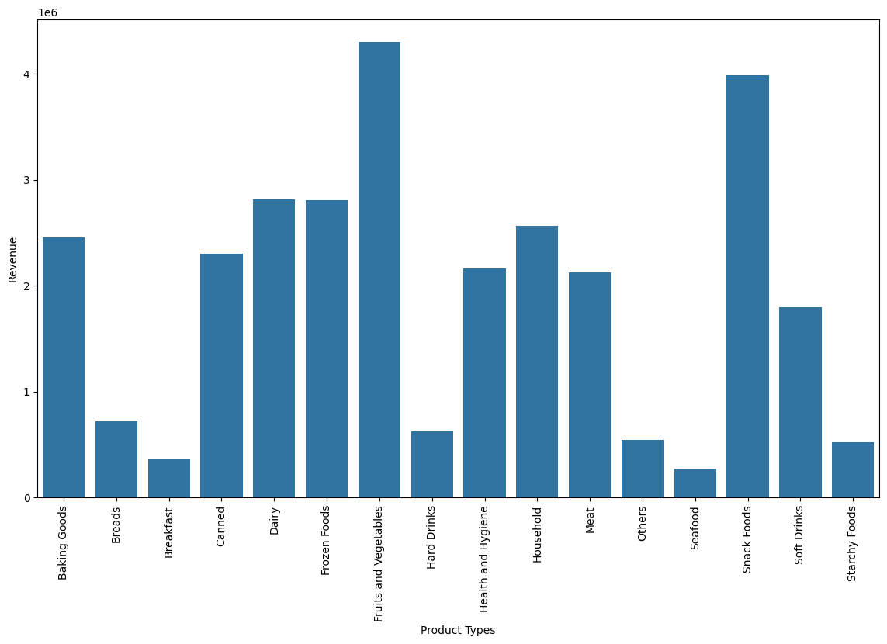
EDA Results Bivariate Analysis: Revenue by Product Type
Fruits and Vegetables generate the highest total revenue among all product categories.
Snack Foods is the second-largest revenue contributor, indicating strong customer demand.
Dairy and Frozen Foods also contribute significantly to overall revenue performance.
Seafood, Breakfast, and Starchy Foods generate the lowest revenues across categories.
Revenue distribution is concentrated among a few major product categories, suggesting key dependence on high-performing food segments.

Slide 20
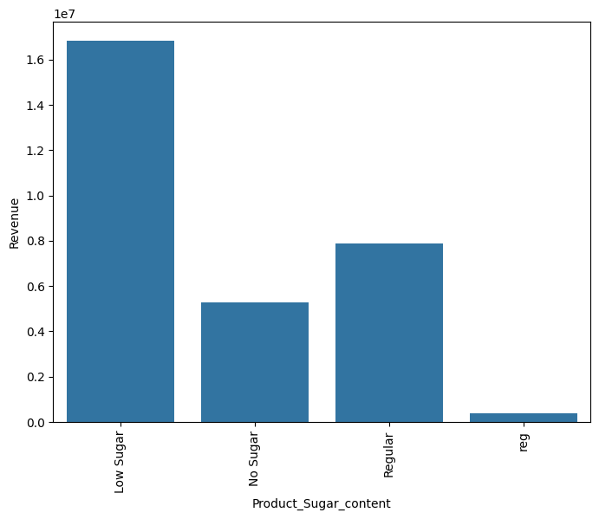
EDA Results Bivariate Analysis: Revenue by Product Sugar Content
Low Sugar products generate the highest total revenue by a significant margin.
Regular sugar products are the second-largest revenue contributors.
No Sugar products contribute moderate revenue compared to Low Sugar products.

Slide 21
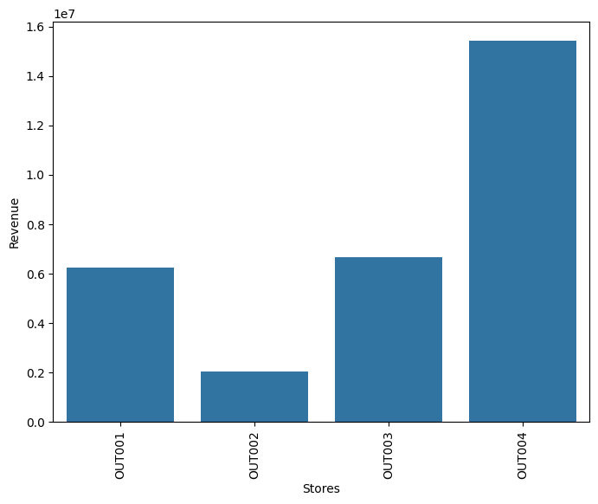
EDA Results Bivariate Analysis: Revenue by Store
OUT004 generates the highest revenue among all stores by a substantial margin.
OUT003 and OUT001 produce moderate revenue levels, with relatively similar performance.
OUT002 generates the lowest revenue across the four stores. Revenue distribution is uneven across store locations, indicating significant differences in store performance.

Slide 22
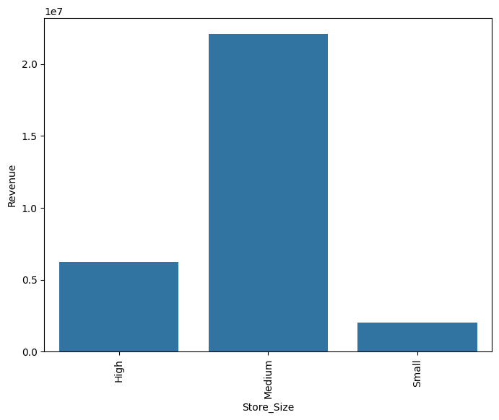
EDA Results Bivariate Analysis: Revenue by Product Store Size
Medium-sized stores generate the highest total revenue by a significant margin.
High-sized stores contribute moderate revenue compared to medium stores.
Small stores generate the lowest overall revenue.
Revenue distribution aligns closely with the higher concentration of medium-sized stores in the dataset.

Slide 23
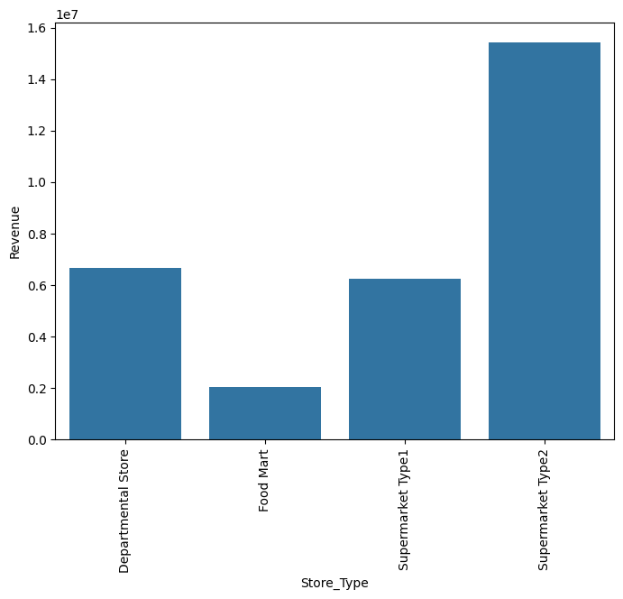
EDA Results Bivariate Analysis: Revenue by Store Type
Supermarket Type2 generates the highest total revenue among all store types by a large margin.
Department Stores and Supermarket Type1 contribute moderate and relatively similar revenue levels.
Food Mart produces the lowest overall revenue.
Revenue concentration is heavily skewed toward the Supermarket Type2 format.

Slide 24
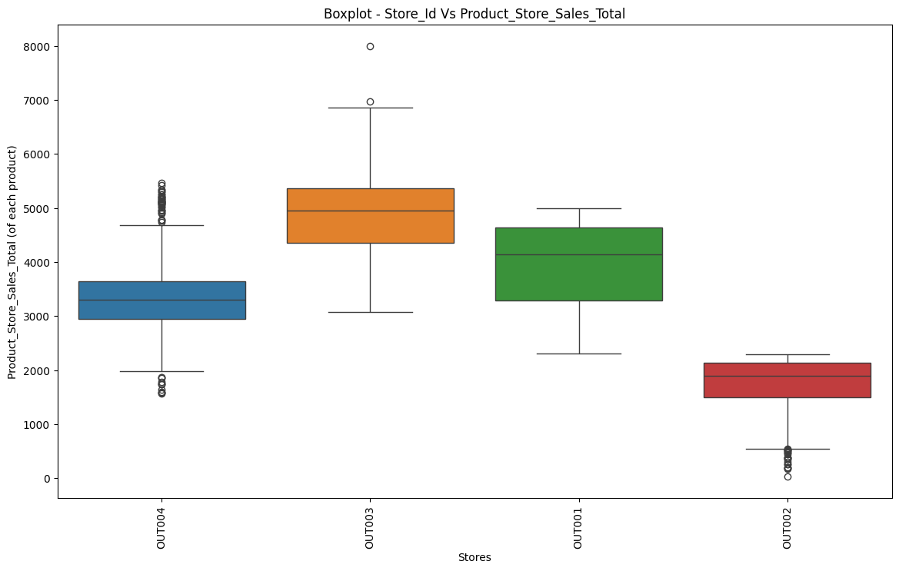
EDA Results Bivariate Analysis: Store vs Product Store Sales
OUT003 has the highest median product sales among all stores.
OUT002 shows the lowest median sales and the narrowest sales distribution.
OUT001 and OUT004 demonstrate moderate sales performance with relatively wider variability.
OUT003 and OUT004 contain several high-value outliers, indicating some exceptionally strong-selling products.

Slide 25
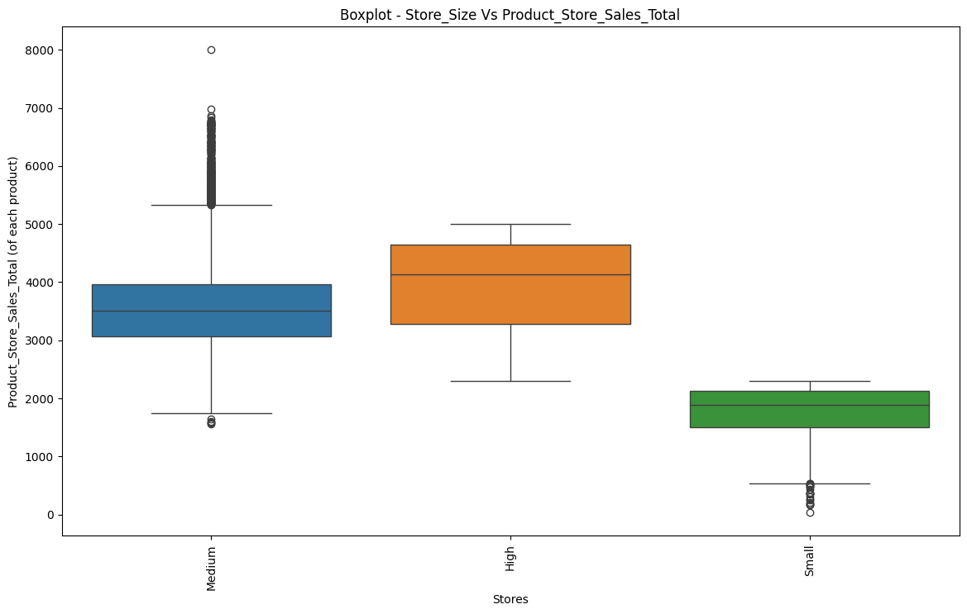
EDA Results Bivariate Analysis: Store Size vs Product Store Sales
High-sized stores have the highest median product sales among all store sizes.
Small stores show the lowest median sales and the narrowest sales distribution.
Medium-sized stores demonstrate moderate sales performance with a large number of high-value outliers.
Medium stores contain the highest variability in sales, indicating inconsistent product performance across locations.

Slide 26
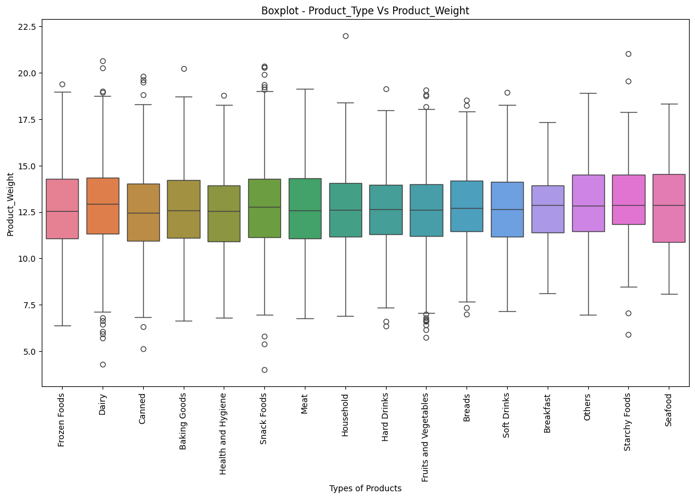
EDA Results Bivariate Analysis: Product Type vs Product Weight
Product weight distributions are relatively similar across most product categories, with medians centered around 12–13 units.
Seafood, Starchy Foods, and Others show slightly higher median product weights compared to other categories.
Dairy and Fruits & Vegetables exhibit several low-weight outliers.
Most categories contain outliers on both the lower and higher ends, indicating variability in packaging sizes within categories.

Slide 27
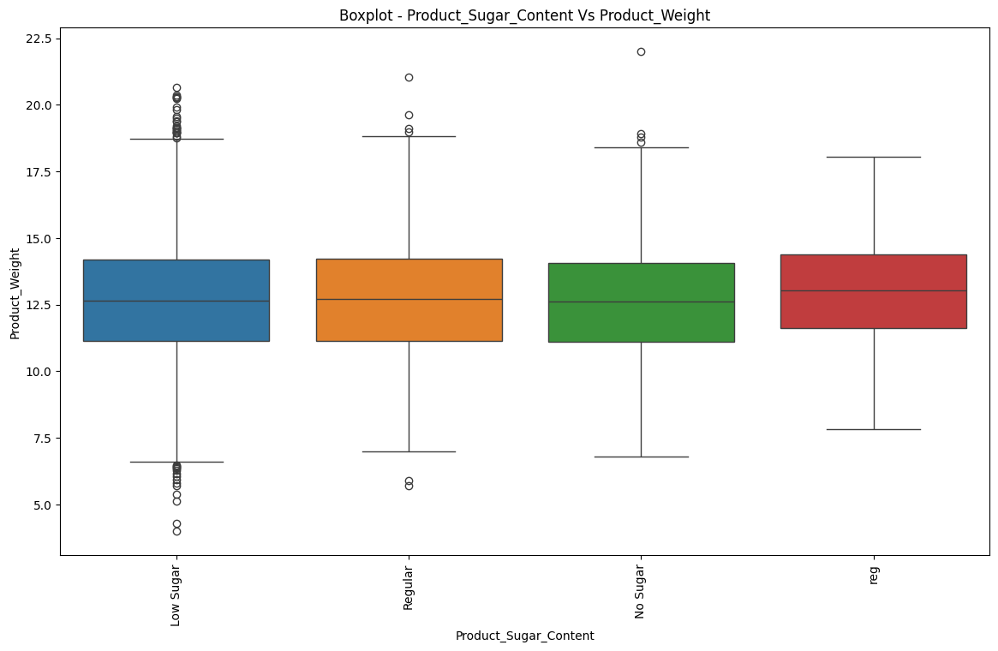
EDA Results Bivariate Analysis: Sugar Content vs Product Weight
Product weight distributions are very similar across all sugar content categories.
The “reg” category shows a slightly higher median product weight compared to the other groups.
Low Sugar products display the widest range of weight outliers on both the lower and higher ends.
No Sugar and Regular categories exhibit relatively consistent weight distributions with moderate variability.

Slide 28
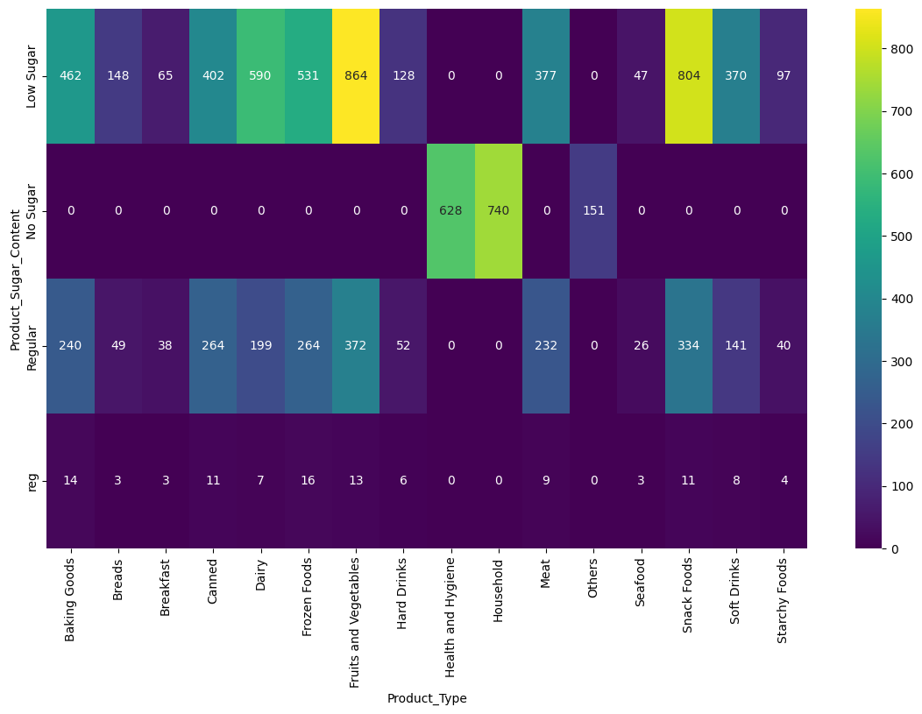
EDA Results Bivariate Analysis: Sugar Content vs Product Type
Low Sugar products dominate most product categories, particularly Fruits & Vegetables and Snack Foods.
No Sugar products are heavily concentrated in Health & Hygiene and Household categories.
Regular sugar products are present across many food-related categories but at lower counts than Low Sugar products.

Slide 29
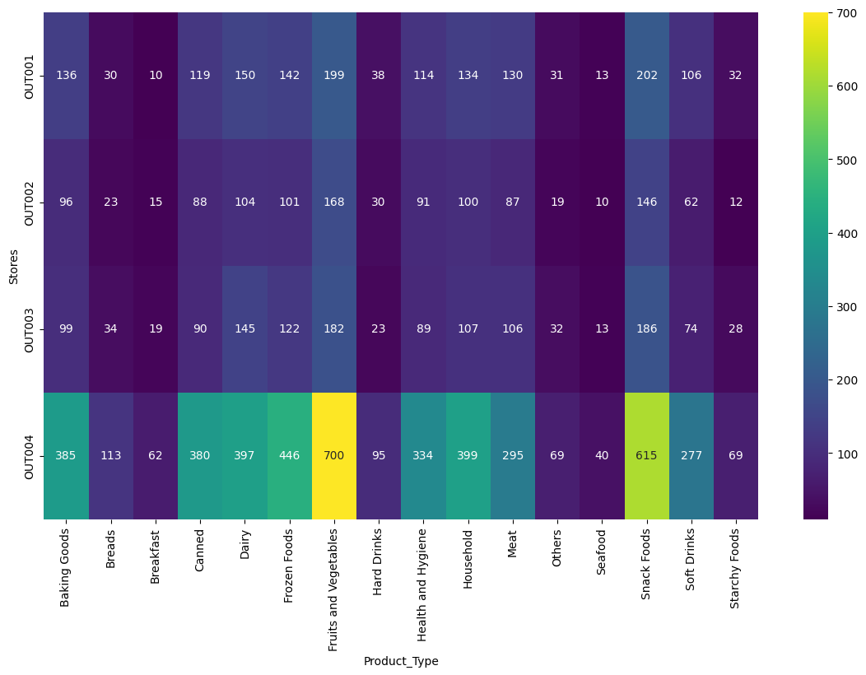
EDA Results Bivariate Analysis: Product Type vs Stores
OUT004 has the highest product counts across nearly all product categories.
Fruits & Vegetables and Snack Foods are the most represented categories across all stores.
OUT002 consistently shows the lowest product counts across most product types.
Product distribution patterns are relatively similar across stores, but inventory volume differs significantly.

Slide 30
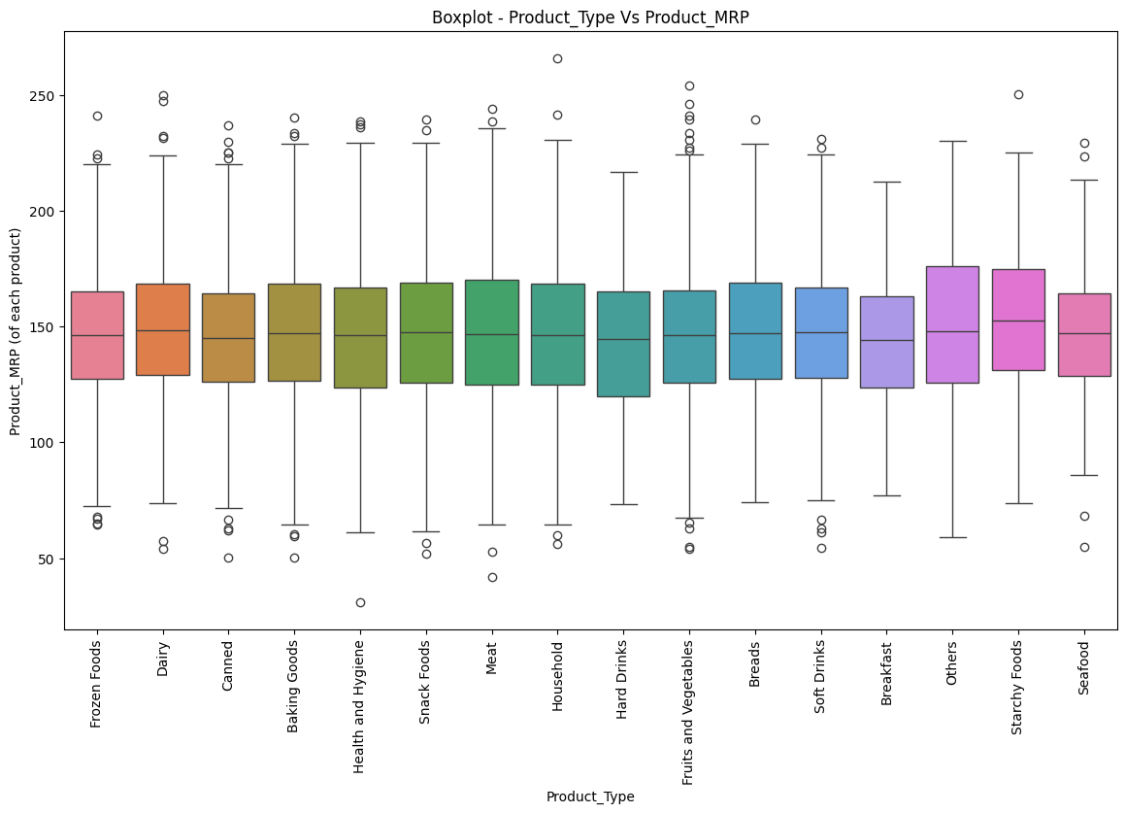
EDA Results Bivariate Analysis: Product Type vs Product MRP
Product MRP distributions are relatively similar across most product categories, with median prices generally centered around 140–150.
Starchy Foods and Others show slightly higher median MRPs compared to other categories.
Breakfast and Hard Drinks exhibit slightly lower median price distributions.
Several categories contain high-price outliers above 220, indicating the presence of premium-priced products.

Slide 31
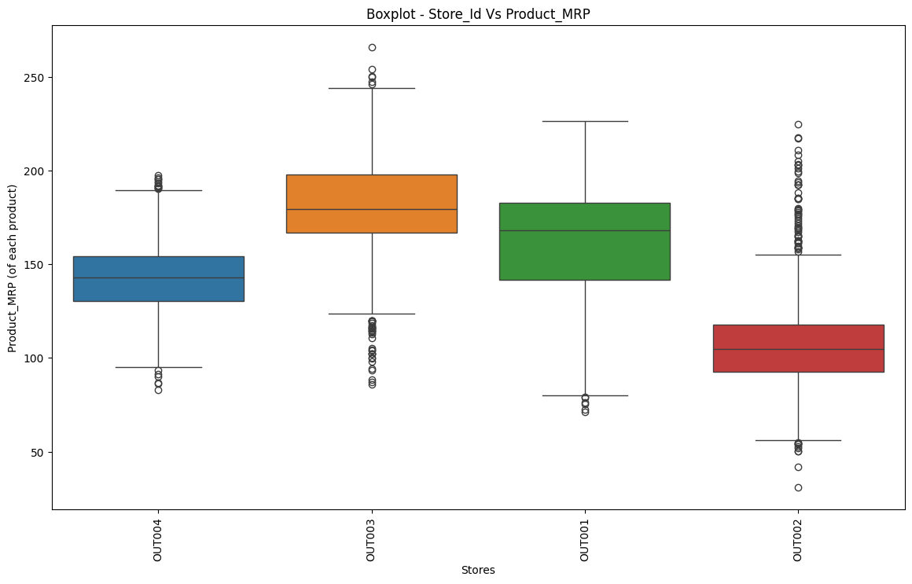
EDA Results Bivariate Analysis: Boxplot Store ID vs Product MRP
OUT003 has the highest median product MRP among all stores.
OUT002 shows the lowest median MRP and the widest concentration of lower-priced products.
OUT001 and OUT004 maintain moderate pricing distributions compared to the other stores.
OUT003 contains several high-price outliers above 240, indicating a stronger presence of premium-priced products.

Slide 32
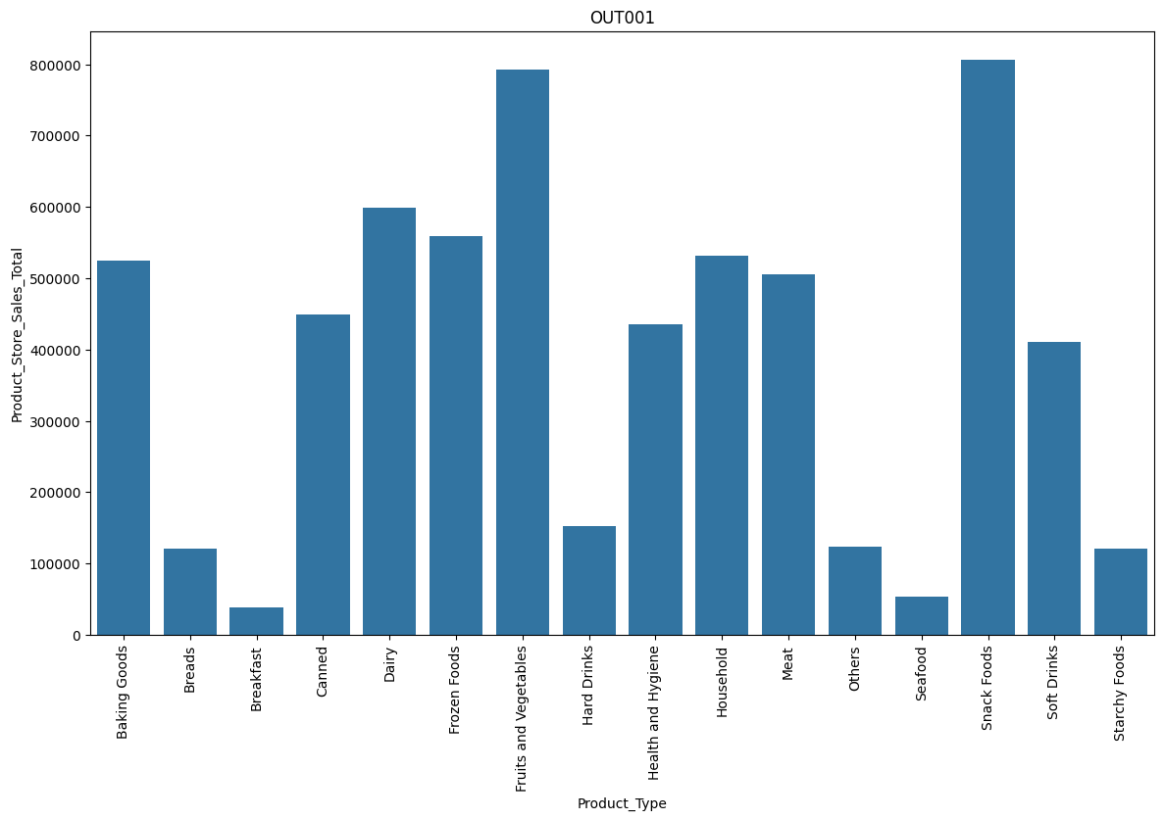
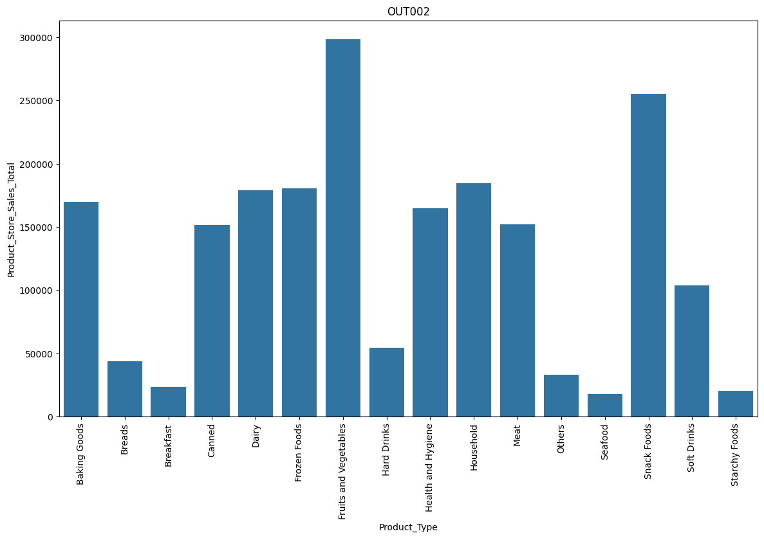
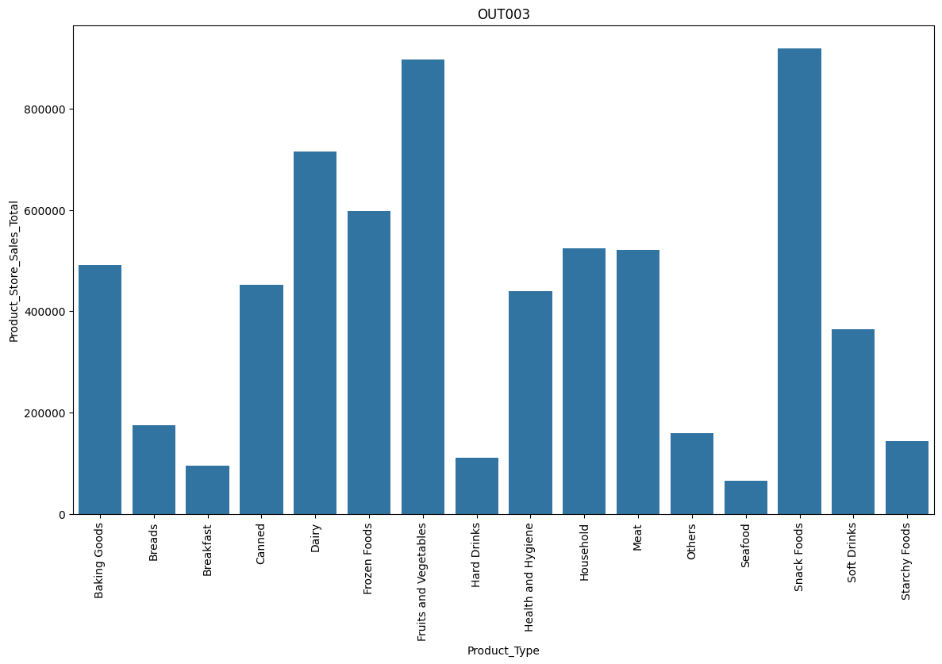
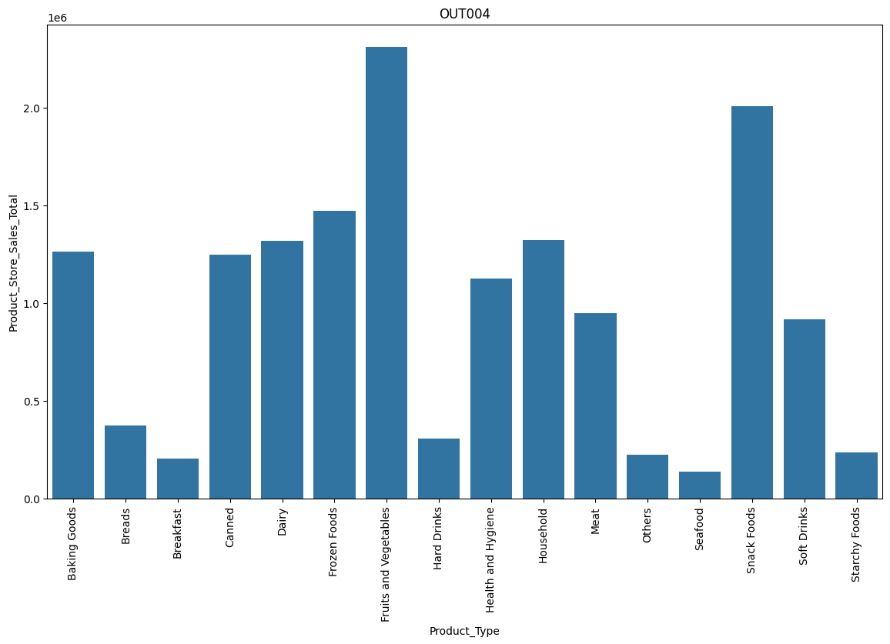
EDA Results Revenue by store analysis
OUT004 consistently outperforms all other stores across nearly every product category, making it the strongest revenue-generating store in the portfolio.
Fruits & Vegetables and Snack Foods are the top-performing categories across all four stores, indicating they are the primary drivers of overall sales performance.
OUT002 generates substantially lower revenues compared to the other stores, while OUT001 and OUT003 demonstrate more balanced and diversified category performance.

Slide 33
Data Preprocessing
Description
1
Column Transformation
Drop columns ‘Product_ID’, ‘Product_Type’, ‘Store_ID’, ‘Store_Establishment_Year’
2
The dataset is separated into features (X) and target (y), where X contains all predictor variables and y contains the sales column. (Product_Store_Sales_Total) that the model will learn to predict.
Separate Features and the target column
3
Split the data into train and test sets
X_train.shape (6134, 10) –>Test 70%
X_test.shape (2629, 10) –>Test 30%
A preprocessing transformer is created using make_column_transformer and OneHotEncoder to convert categorical variables into numerical columns.
Categorical values: (Product_Sugar_Content, Store_Size, Store_Location_City_Type, Store_Type, Product_Id_char, and Product_Type_Category)
4
Data Pre-processing Pipeline

Slide 34
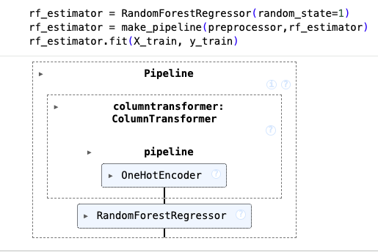
Model Building: Random Forest Model
Hyperparameter Tuning
Random Forest Regressor Model
Performance Metrics
RMSE: 596.99
MAE: 468.87
R-Squared: 0.685
Adj R-Squared: 0.684
MAPE: 0.165
N/A
Training
N/A
RMSE: 615.90
MAE: 485.31
R-Squared: 0.6685
Adj R-Squared: 0.6672
MAPE: 0.1873
Test
The Random Forest Regressor model delivered stable predictive performance, achieving an R-Squared of approximately 0.67–0.69 across training and test datasets. Similar performance metrics between both datasets indicate good generalization with minimal overfitting. Overall, the model provides a reliable regression solution capable of capturing complex nonlinear relationships.

Slide 35
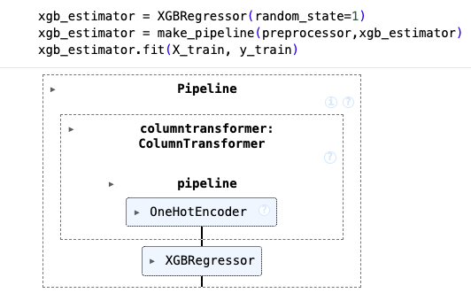
Model Building: XGBoost Regressor
Hyperparameter Tuning
XGBoost Regressor
Performance Metrics
RMSE: 596.97
MAE: 468.96
R-Squared: 0.685
Adj R-Squared: 0.684
MAPE: 0.165
Training
N/A
RMSE: 615.93
MAE: 485.42
R-Squared: 0.6684
Adj R-Squared: 0.6672
MAPE: 0.1874
Test
N/A
The XGBoost Regressor achieved moderate predictive performance, with training and testing R-Squared values around 0.68, indicating the model explains approximately 68% of the variance in the target variable. The relatively close training and testing metrics suggest the model generalizes well with limited overfitting, demonstrating stable performance across unseen data. However, the absence of hyperparameter tuning may have limited the model’s full predictive potential, as further optimization could improve RMSE, MAE, and overall accuracy.

Slide 36
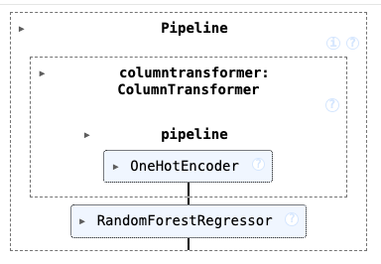
Model Building: Tuned Random Forest Model
Hyperparameter Tuning
Random Forest Regressor Model
Performance Metrics
RMSE: 597.14
MAE: 470.40
R-Squared: 0.6848
Adj R-Squared: 0.684
MAPE: 0.166
max_depth: [5.10.15,20]
max_features: [‘sqrt’, ‘log2’]
n_estimators: [100, 200,30]
Training
max_depth: [5.10.15,20]
max_features: [‘sqrt’, ‘log2’]
n_estimators: [100, 200,30]
çç
RMSE: 615.81
MAE: 486.71
R-Squared: 0.6686
Adj R-Squared: 0.6673
MAPE: 0.1876
Test
The tuned Random Forest Regressor model achieved stable performance, with R-Squared values near 0.67–0.68 across both training and test datasets, indicating consistent predictive capability. Hyperparameter tuning improved model balance and helped minimize overfitting, as shown by the close alignment between training and testing metrics. Overall, the tuned model provides a reliable and well-generalized regression solution with moderate prediction error and strong performance stability.

Slide 37
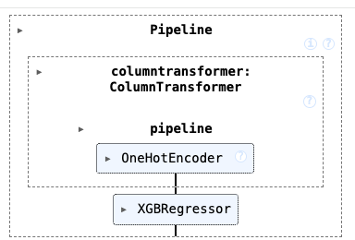
Model Building: Tuned XGBoost Regressor
Hyperparameter Tuning
XGBoost Regressor
Performance Metrics
RMSE: 597.12
MAE: 468.80
R-Squared: 0.684
Adj R-Squared: 0.684
MAPE: 0.165
n_estimators: [50, 100, 200]
subsample: [0.6, 0.8, 1.0]
gamma: [0, 0.1, 0.3, 0.5]
colsample_bytree [0.6, 0.8, 1.0]
colsample by level [0.6. 0.8. 1.0]
Training
n_estimators: [50, 100, 200]
subsample: [0.6, 0.8, 1.0]
gamma: [0, 0.1, 0.3, 0.5]
colsample_bytree [0.6, 0.8, 1.0]
colsample by level [0.6. 0.8. 1.0]
RMSE: 615.75
MAE: 485.01
R-Squared: 0.6686
Adj R-Squared: 0.6674
MAPE: 0.1874
Test
The tuned XGBoost Regressor achieved stable performance, with R-Squared values near 0.67–0.68 across training and test datasets. Hyperparameter tuning improved model stability while minimizing overfitting through optimized sampling and estimator settings. Overall, the model provides a reliable regression solution with balanced predictive accuracy on unseen data.ç

Slide 38
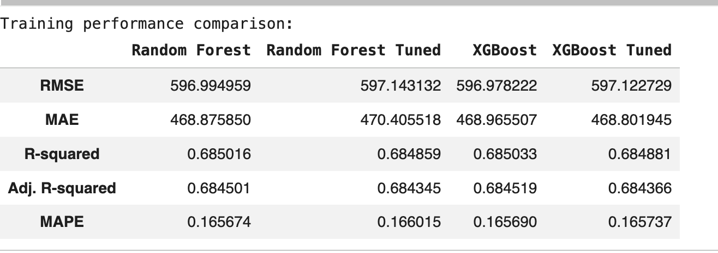
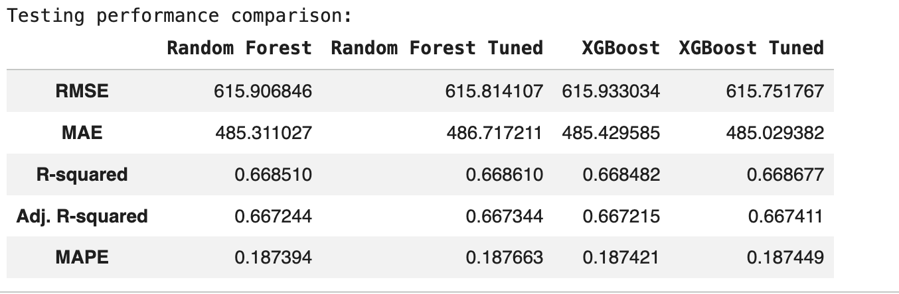
Model Performance Summary
Model Objective
Business objective is to reduced prediction errors
MAPE predicts sales with~81% accuracy
RMSE shows the lowest prediction error (615.7)
XGBoost Tuned was selected because it achieved the lowest prediction error (RMSE, MAE, and MAPE) and the highest explanatory power (R²) on the test dataset, making it the most accurate and reliable model for forecasting future sales.

Slide 39
Deployment - Backend
Description
1
Serialization
web app deployment folder-> os.makedirs("backend_files", exist_ok=True)
saved_model_path -> backend_files/superkart_xgb_tuned.joblib
test saved model -> saved_model.predict(X_test)
2
home page api > @superkart_api.get('/’)
endpoint to predict churn -> @superkart_api.post('/v1/predict’)
extract customer features and convert them into a DataFrame
Flask Web Framework
3
writefile backend_files -> requirements.txt [pandas, numpy, joblib xgboost, flask, gunicorn, uviorn, etc..)
docker file - > commands in Docker [WORKDIR, COPY, RUN]
Install dependencies -> requirements file
Setting up a Docker Space
(Hugging Face)
4
Uploading to Docker Space
(Hugging Face)
Hugging Face import login - HfApi -> access_key & repo_id
Initialize api = HfAPI( )
Upload Streamlit app files -> backend_files, repo_id, space

Slide 40
Deployment - Backend
Description
5
Hugging Face Hub API
Import the login function -> from huggingface_hub import login
Define access token -> login (token = )
Huggingface_hub -> create_repo
6
Create Repository
create_repo -> "superkart-salespred"
repo_type -> ‘space’
space_dsk -> ‘docker’

Slide 41
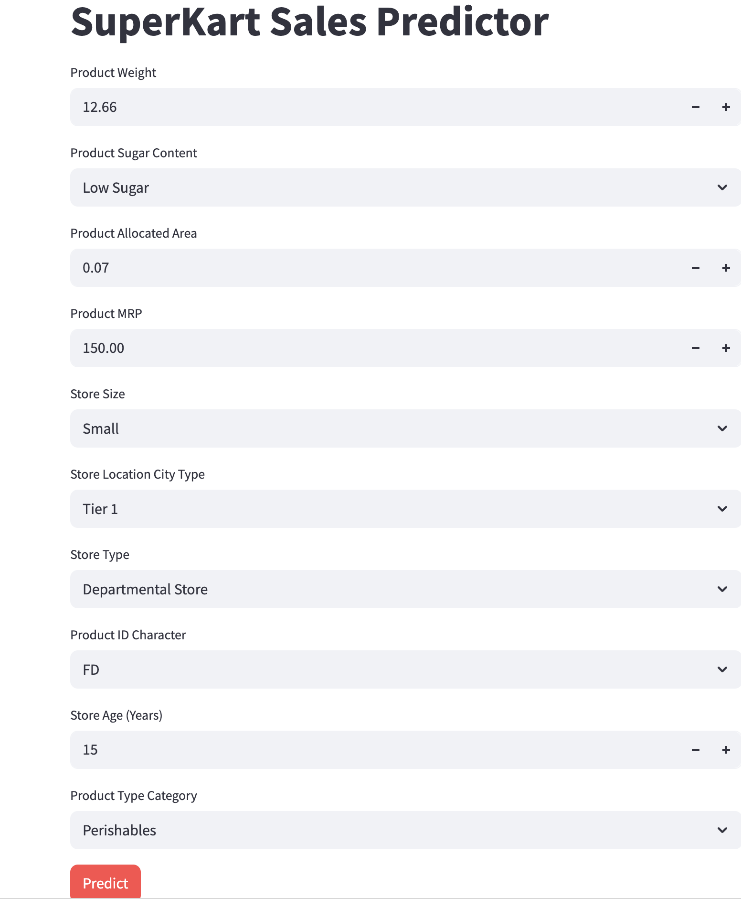
Deployment - Frontend
User Interface Intake Form
Uploading Files to Hugging Face
1, Define access keys and tokens:
access_key
repo_id
2. Initialize the API:
api=HfApi ()
3. Upload Streamlit app files:
frontend_files
repo_id
space
4. repo_url
https://huggingface.co/spaces/ccy2k/superkart-salespred'

Slide 42
Conclusions and Recommendations
Conclusions:
EDA identified key product, store, and location factors influencing sales performance, with notable differences across product categories, store formats, and locations.
Four regression models were evaluated: Random Forest, Tuned Random Forest, XGBoost, and Tuned XGBoost. Performance was measured using RMSE, MAE, MAPE, and R².
The Tuned XGBoost Regressor achieved the lowest prediction errors and highest R² score, making it the best-performing model.
Based on its superior accuracy and ability to generalize on unseen data, the Tuned XGBoost Regressor was selected as the final model for deployment and future sales forecasting.
Recommendations:
Deploy the Tuned XGBoost Regressor as the production model for sales forecasting.
Regularly retrain and monitor the model using new sales data to maintain performance.
Use forecast results to support inventory planning, demand forecasting, and operational decision-making.
Continue enhancing the model by incorporating additional business factors such as promotions, seasonality, and market trends.

